Slide 1





ComprehensIve AnalysIs of MovIe Datasets

Slide 2

topIcs
1
2
Introduction
Objectives
3
4
Data Engineering
datasets
Data Visualization
Machine Learning
5
6

Slide 3





INTRODUCTION
Movie production is one of the fastest-growing industries that combines art, business, and culture to entertain, educate, and create trends. They are typically shown in theaters, on television, or through streaming platforms, and have become a global language that connects people across borders, affecting their perspective on the world as movies raise awareness.

Slide 4
Objective
1
2
Creating consistent visualizations that tell a story.
Help in decision-making for the top movie production companies.
3
4
·Provide insights/tips for relatively small movie production companies to increase revenue.
Build a machine learning model that can predict the movie overall revenue after release.

Slide 5

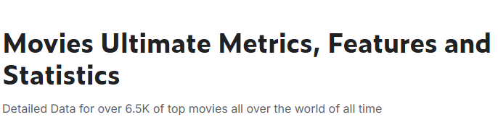

Datasets 1
Dataset issue: Alot of NaN values

Slide 6

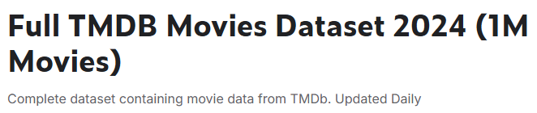
Datasets 2
Dataset issue: Alot of unnreliable records

Slide 7
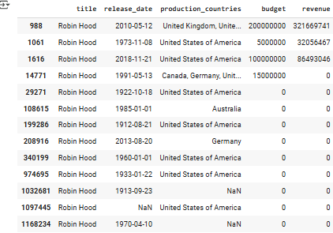

Datasets 2

Slide 8


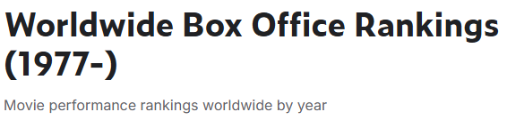
Datasets 3
Dataset issue: Each year has only 200 records

Slide 9

Datasets 4
Dataset issue: Domestic revenue

Slide 10


Datasets 5

Slide 11

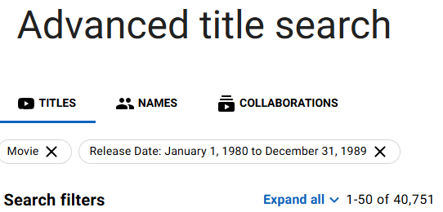
Datasets 6

Slide 12
DATA ENGINEERING
1
data understanding and cleansing
2
Data Merge
3
feature engineering

Slide 13
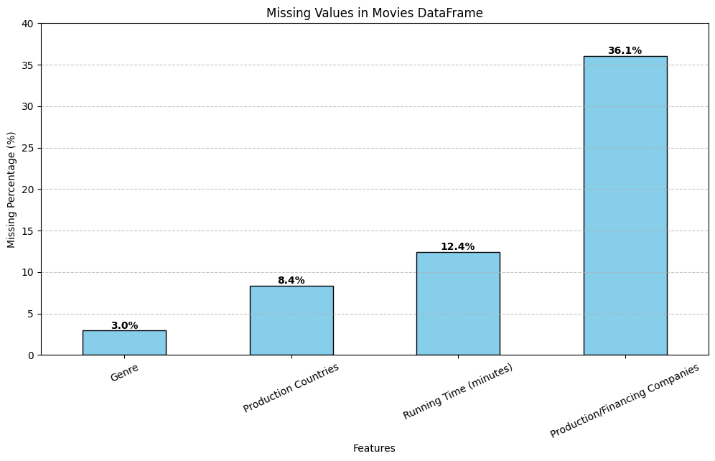
Data engIneerIng
Missing values percentage for a number of features

Slide 14
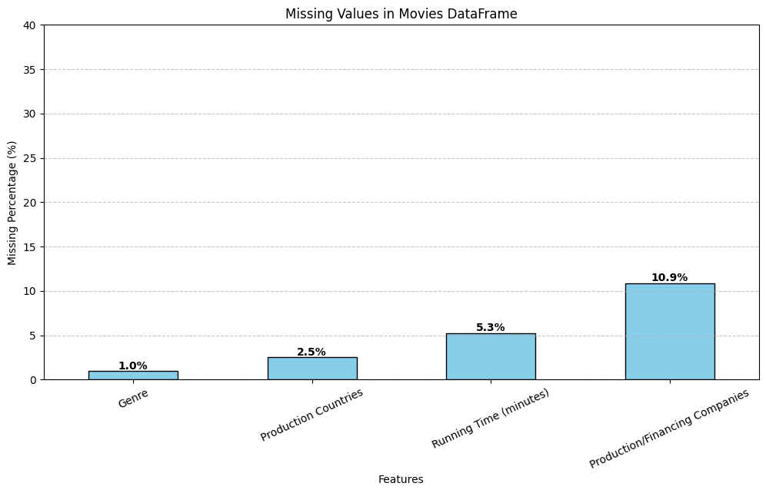
Data engIneerIng
+
Missing values percentage for a number of features

Slide 15
Data engIneerIng
BEFORE MERGE
AFTER MERGE

Slide 16

Data engIneerIng
+
+
Shape before merge was:
8800
Shape after merge Became:
19700

Slide 17
Data
VISUALIZATION

Slide 18
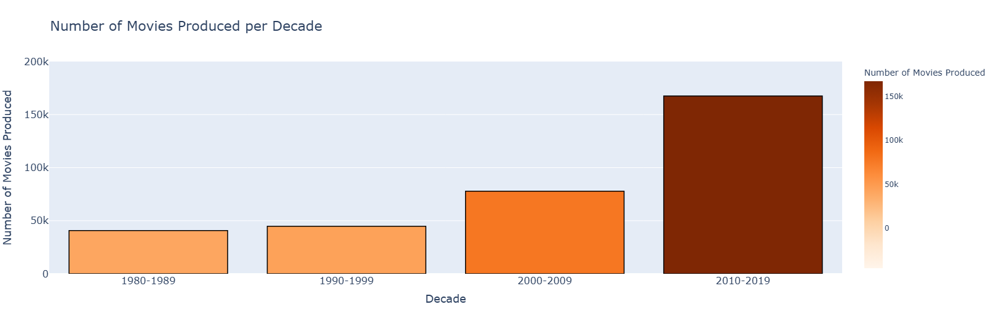

Q1) Are movies a growing industry?
We can see clearly that the movie industry is a growing industry, with thousands of movies produced every year. This trend also indicates that the movie industry is getting more competitive.
This means that as a production company, you must understand the audience preferences to ensure movie success.

Slide 19
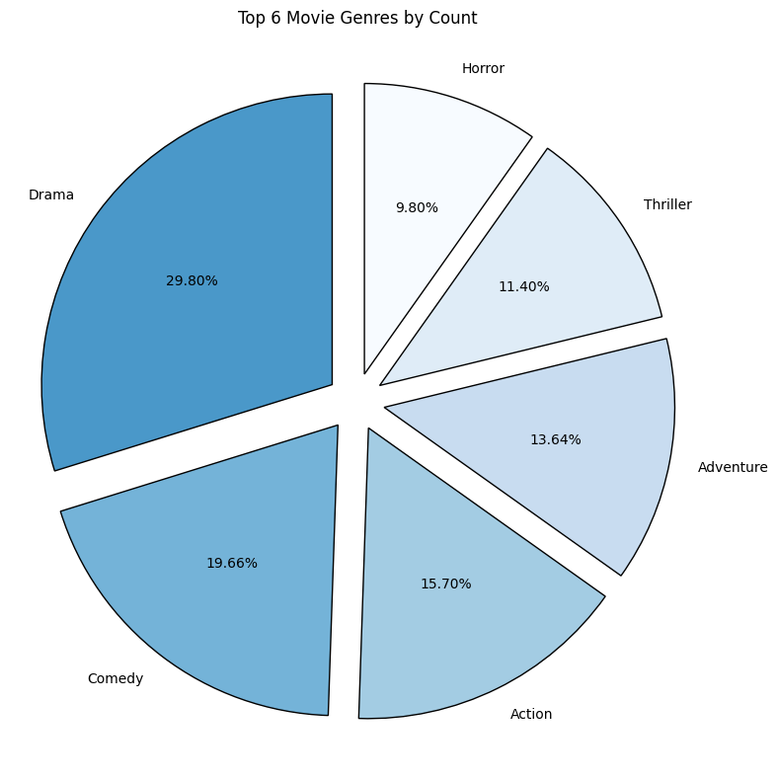
Q2) What are the most common genres?
We can see that Drama is the most common genre, making up nearly 30% of the dataset. Why might that be the case?

Slide 20
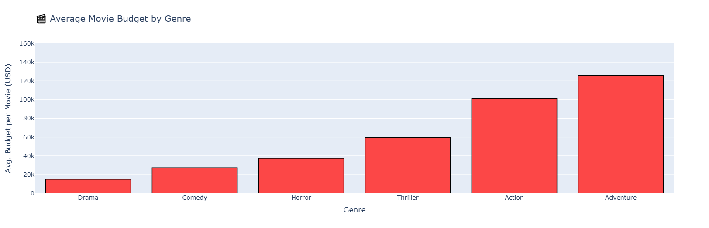
Q2
We can observe that the most common genres (e.g. Drama and Comedy) tends to have the lowest average budget. As a result, despite their popularity and frequent production, they generally require less investment compared to high-budget genres like Adventure or Action.

Slide 21
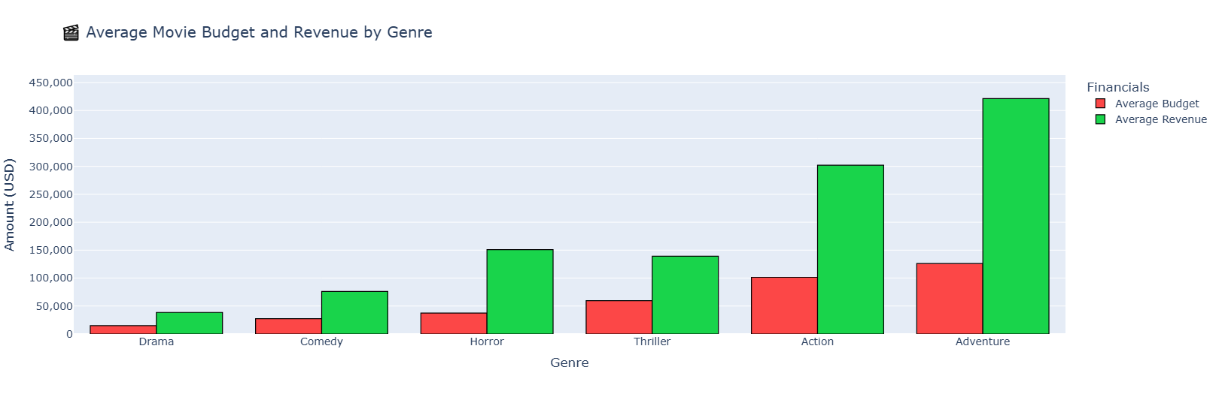
Q2

Slide 22
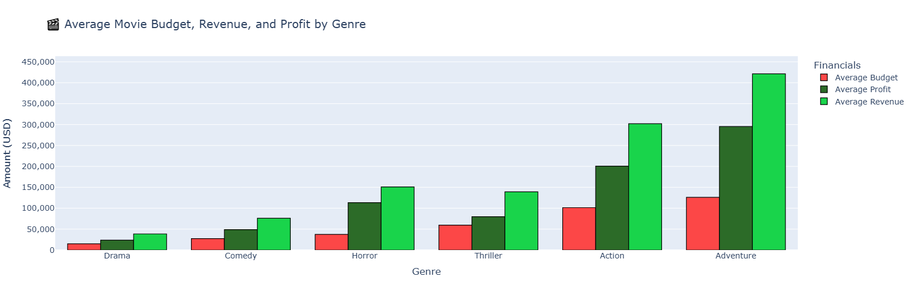
Q2

Slide 23

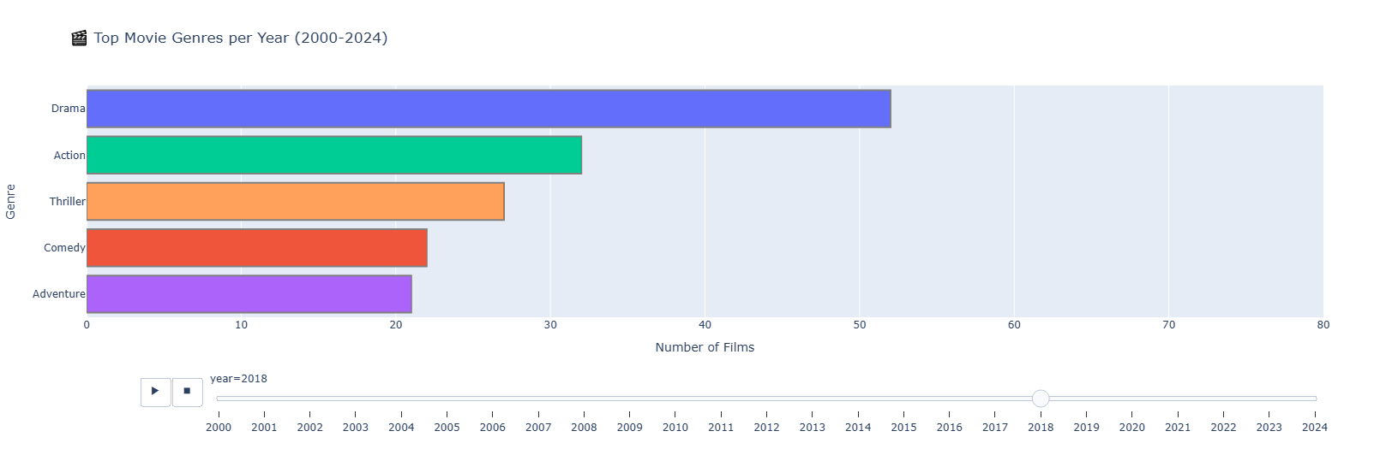
Q3) What are the trending genres?

Slide 24
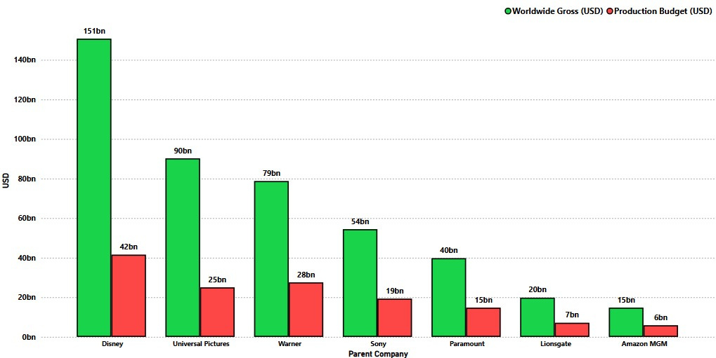
Q4) What are the top movie production companies?
This chart highlights the financial performance of major film studios over several decades, comparing their total production budgets with total revenues.

Slide 25
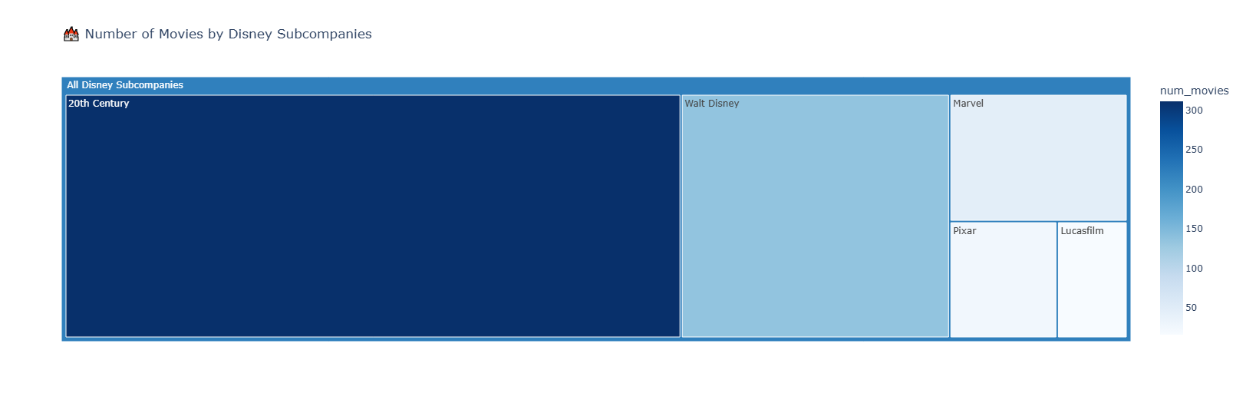
Q4

Slide 26
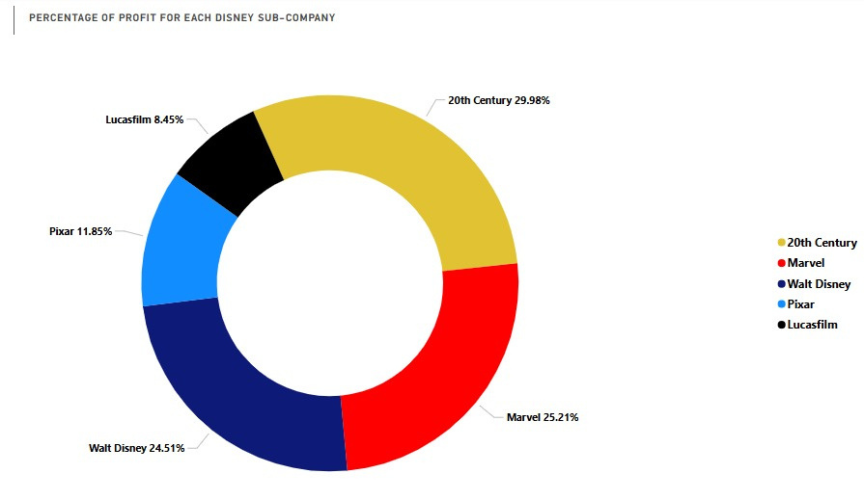
Q4

Slide 27
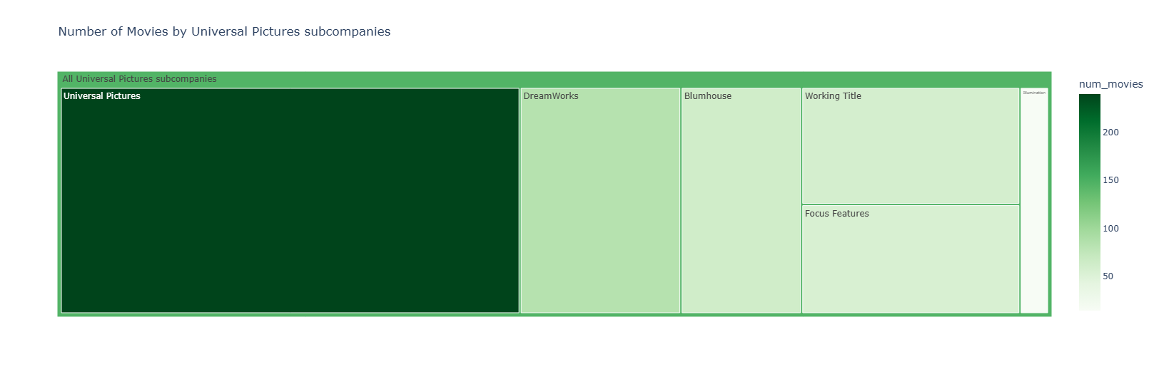
Q4

Slide 28
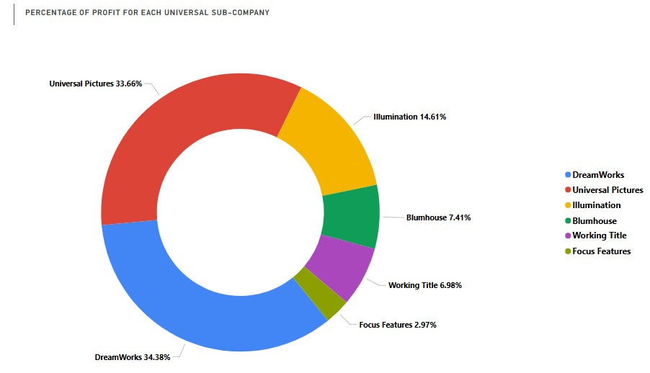
Q4

Slide 29

Q5) Do top movie studios tend to produce more adult oriented or child friendly content?
Grouped for Adults
Grouped for UNDERAGE

Slide 30
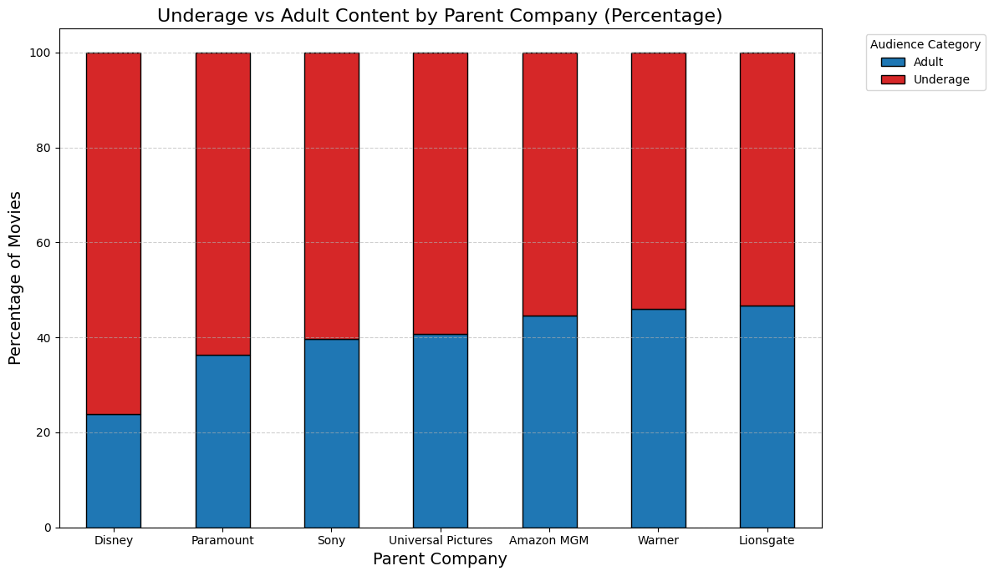
Q5) Do top movie studios tend to produce more adult oriented or child friendly content?

Slide 31
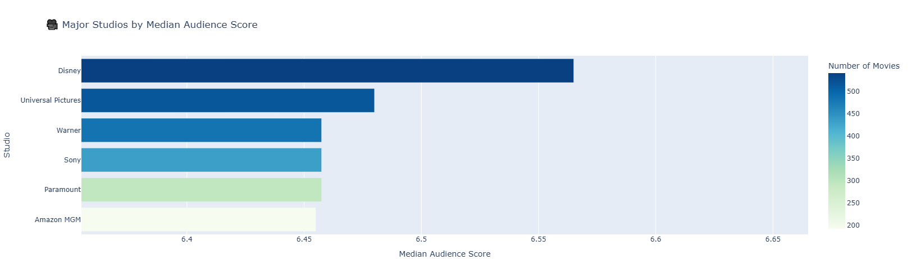
Q6) What is the vote scores for the top movie production studios?
Question: Does this chart contribute with the movies revenue?
Yes it does, remember the chart in "Question three", We can see that Disney has the highest revenue which correspond with the highest median audience score!
Additionally, we can observe that since Disney target audience is children, parents must like Disney content, giving very high median rating!

Slide 32
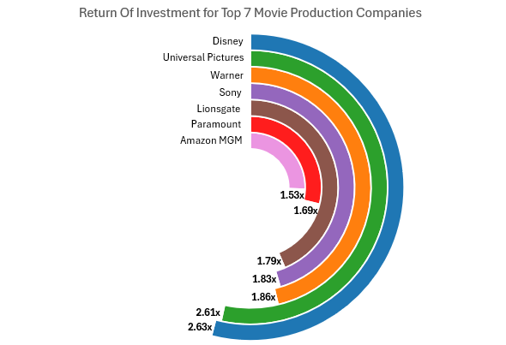
Q7) What is the Return Of Investment (ROI) for the biggest movie production companies?

Slide 33
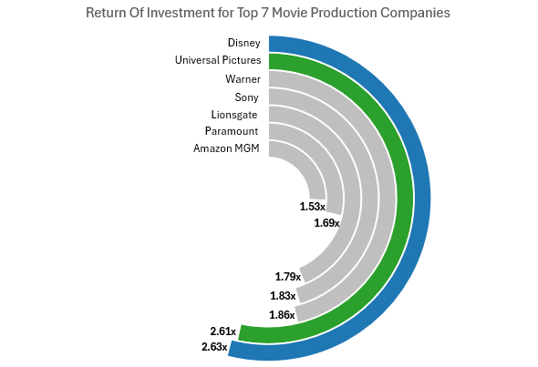
Q7) What is the Return Of Investment (ROI) for the biggest movie production companies?

Slide 34
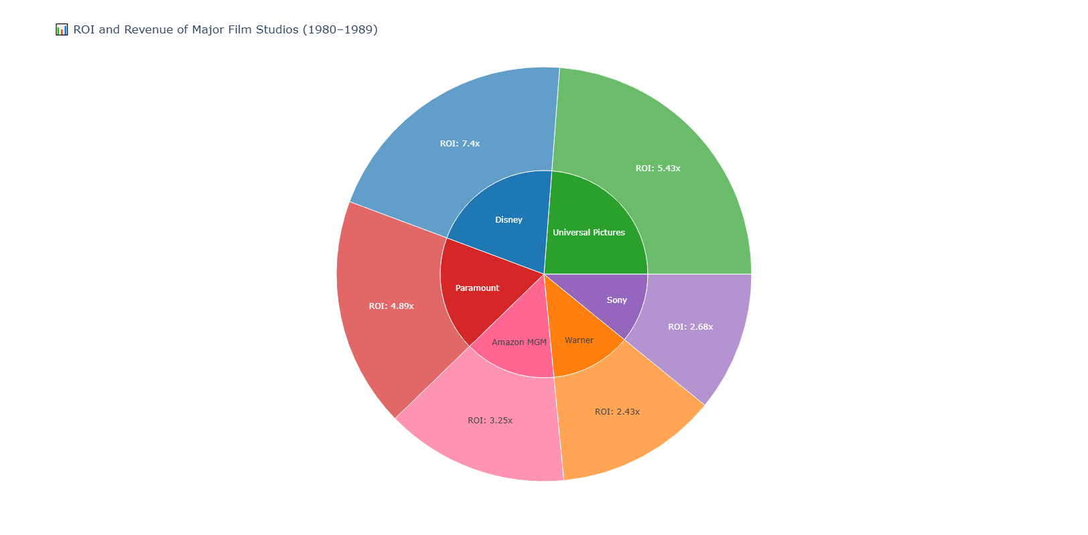
Q7) What is the Return Of Investment (ROI) for the biggest movie production companies?

Slide 35
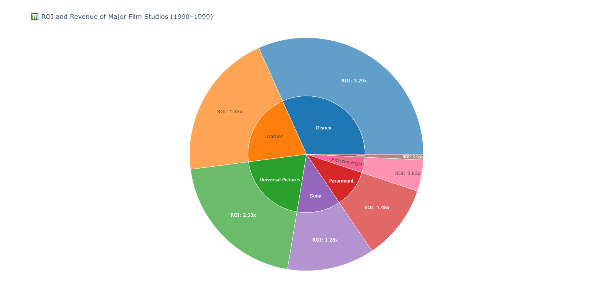
Q7) What is the Return Of Investment (ROI) for the biggest movie production companies?

Slide 36
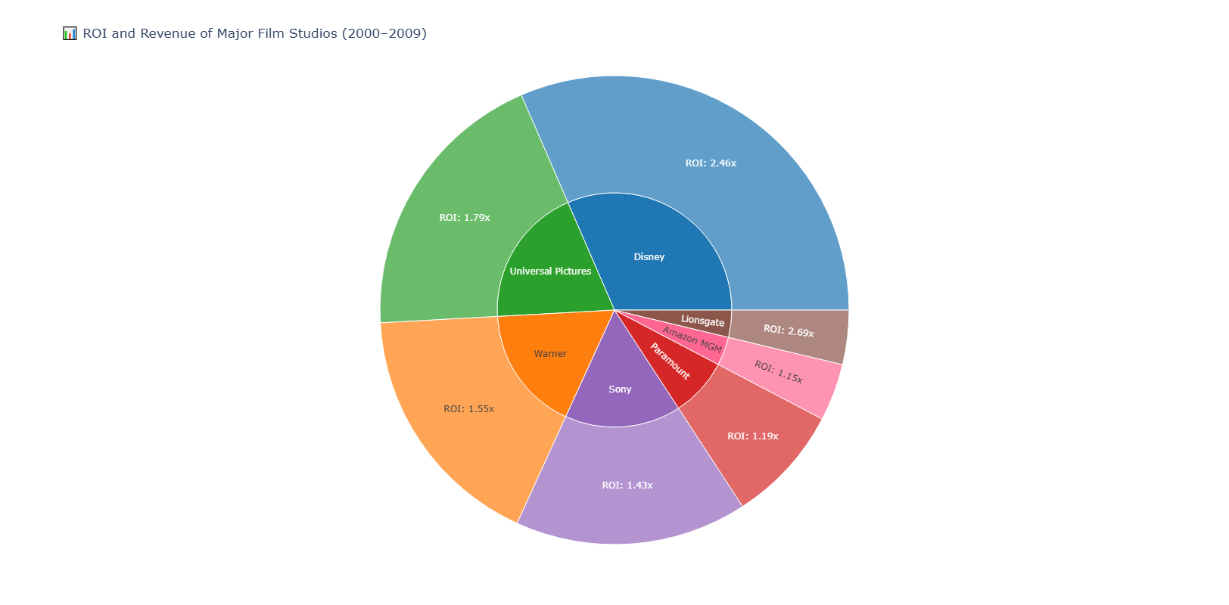
Q7) What is the Return Of Investment (ROI) for the biggest movie production companies?

Slide 37
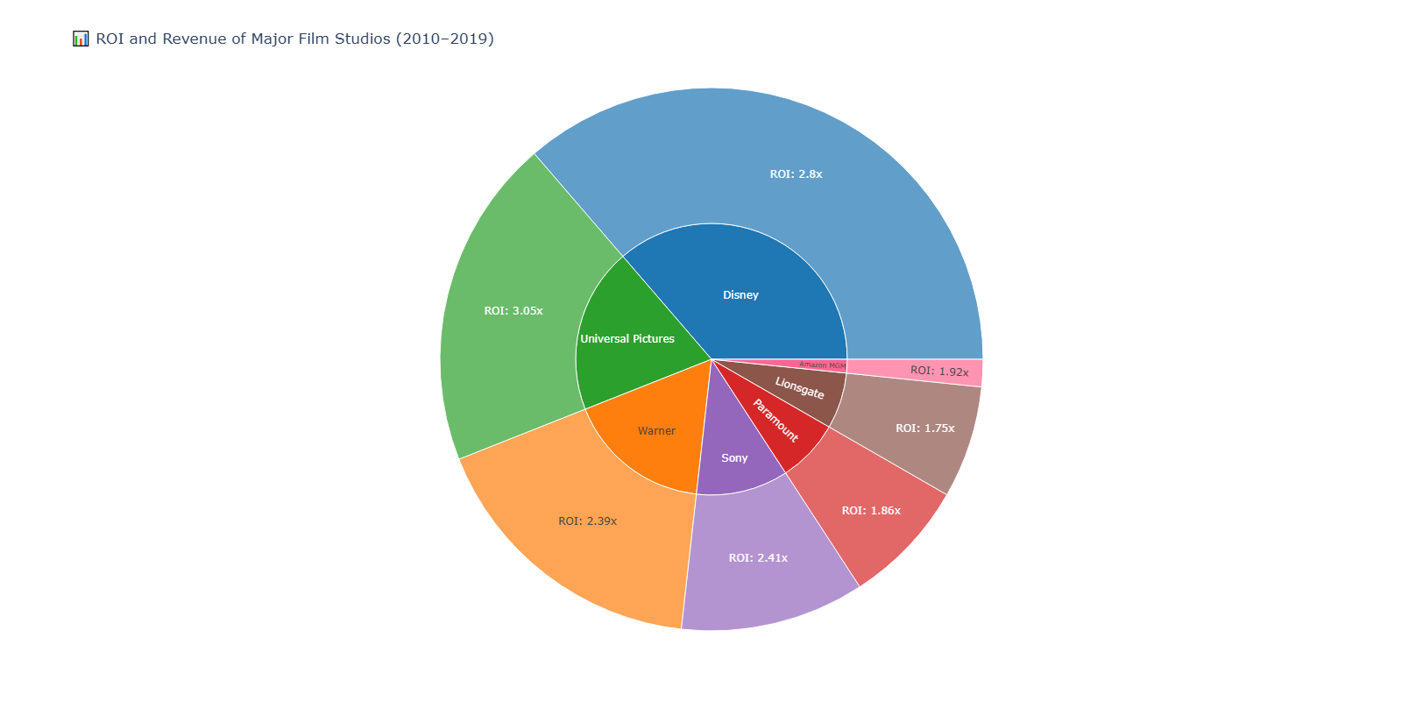
Q7) What is the Return Of Investment (ROI) for the biggest movie production companies?

Slide 38
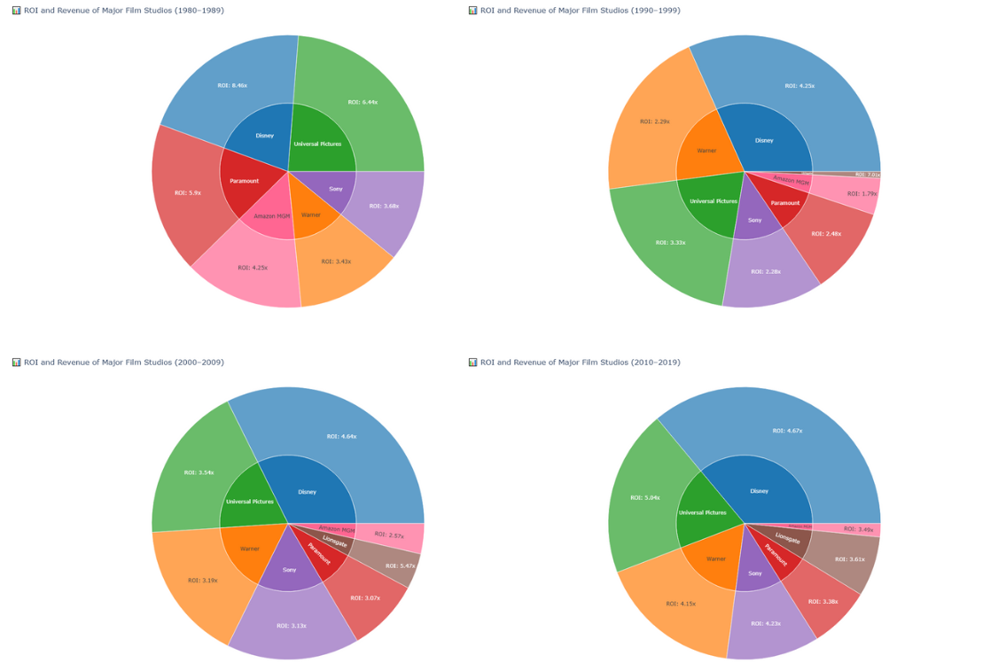
Q4

Slide 39

Q8) Should companies release movies during official holiday days or not?
Problem: The number of movies released during the holiday was around the 300 mark records, however, the non-holiday releases were over 5000 records. This is UNFAIR comparison, BIAS.
Solution: We took the same holiday records, and compaired them with 6 different unique records from the non-holiday records.

Slide 40
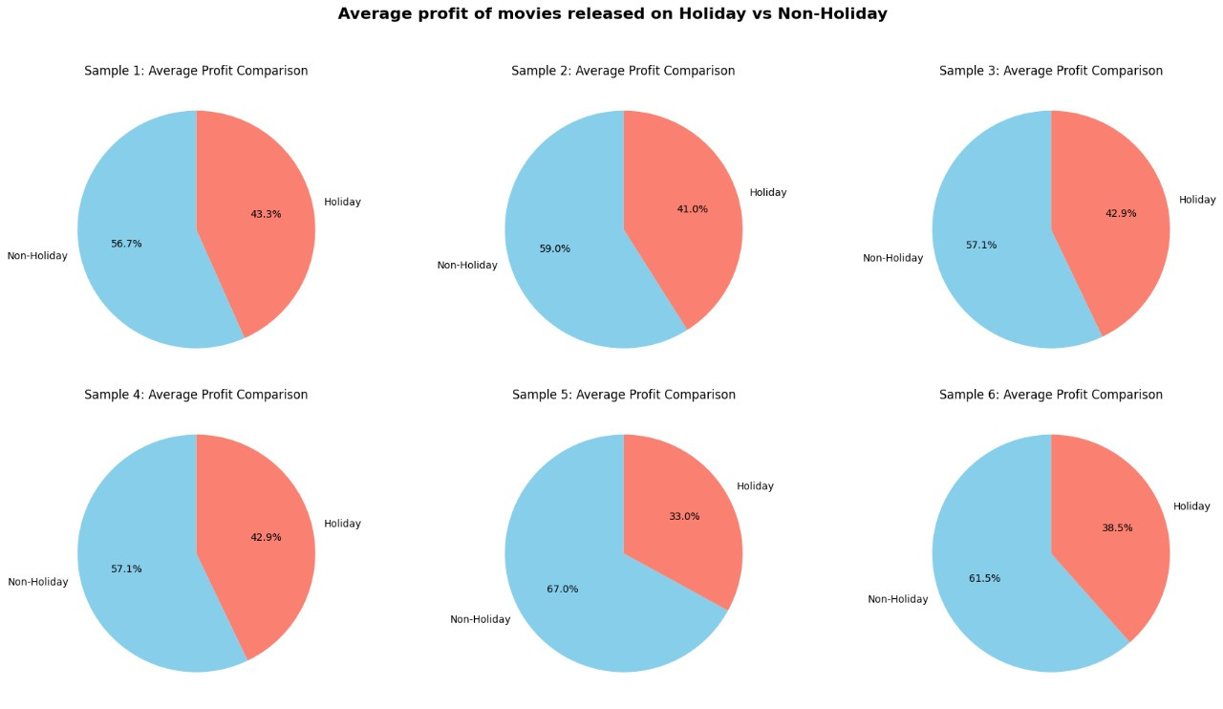
Q8) Should companies release movies during official holiday days or not?

Slide 41
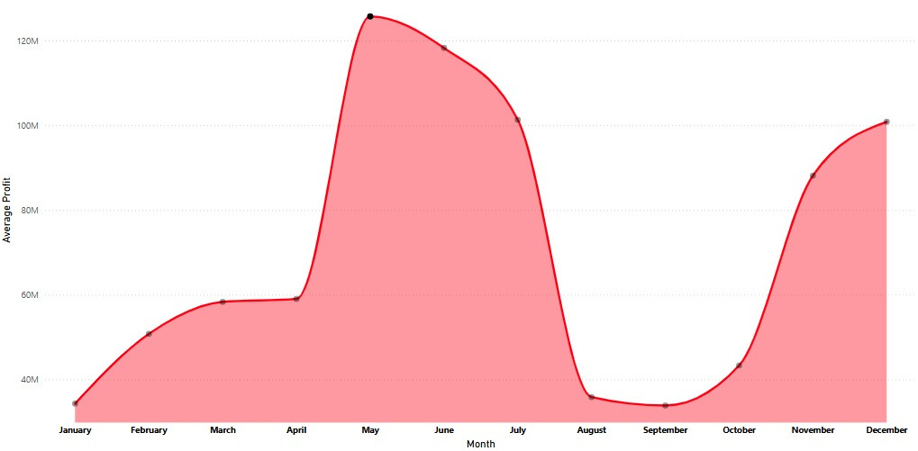
Q9) What is the most profitable month and day to release a movie on?

Slide 42
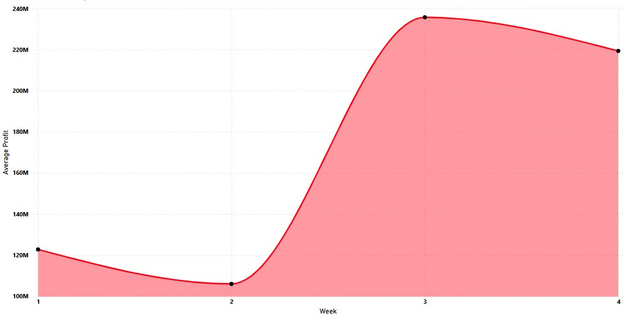
Q9) What is the most profitable month and day to release a movie on?

Slide 43
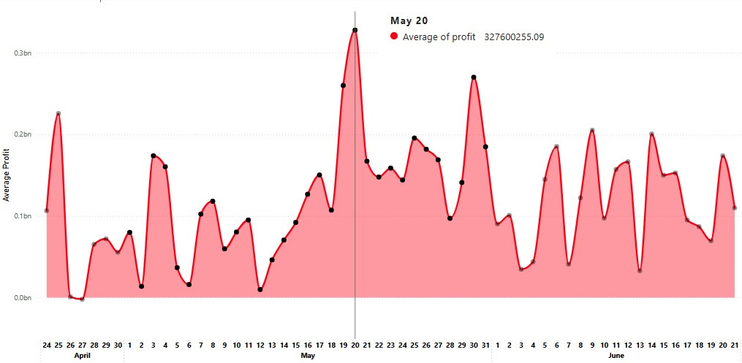
Q9) What is the most profitable month and day to release a movie on?

Slide 44
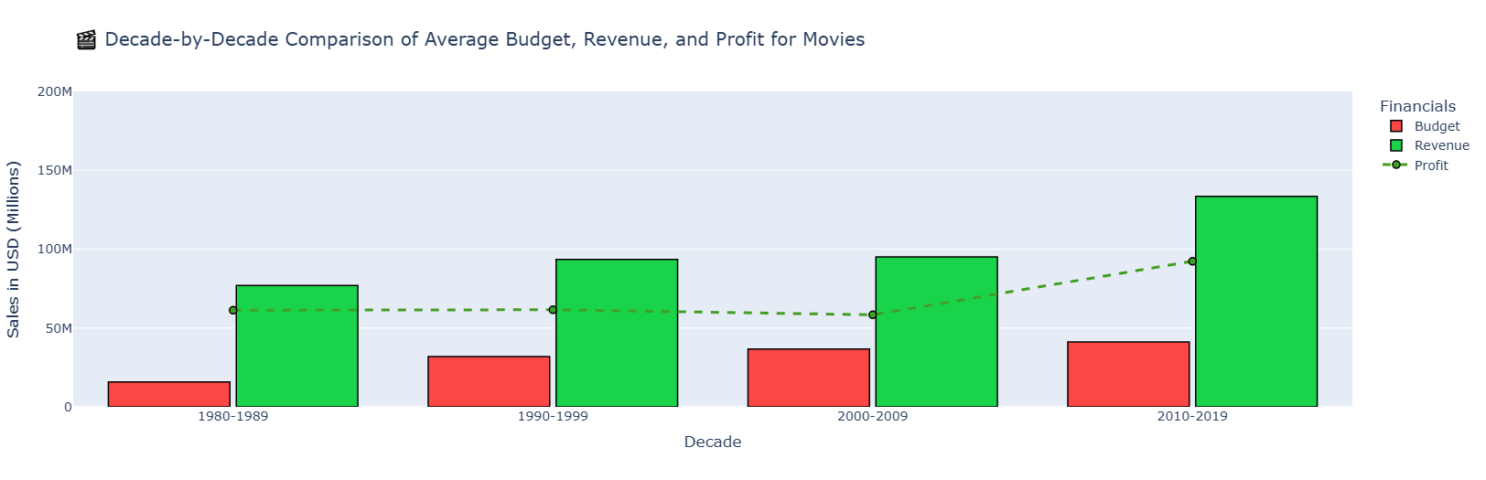
Q10) Does the movies budget and revenue increase with time? Is it a profitable relationship?

Slide 45
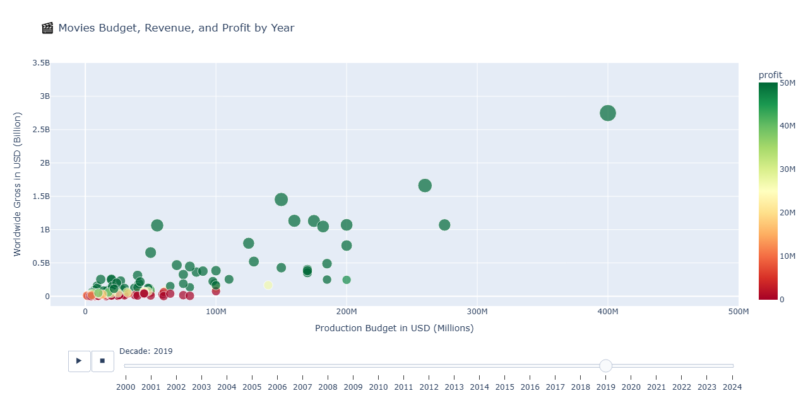
Q10) Does the movies budget and revenue increase with time? Is it a profitable relationship?

Slide 46
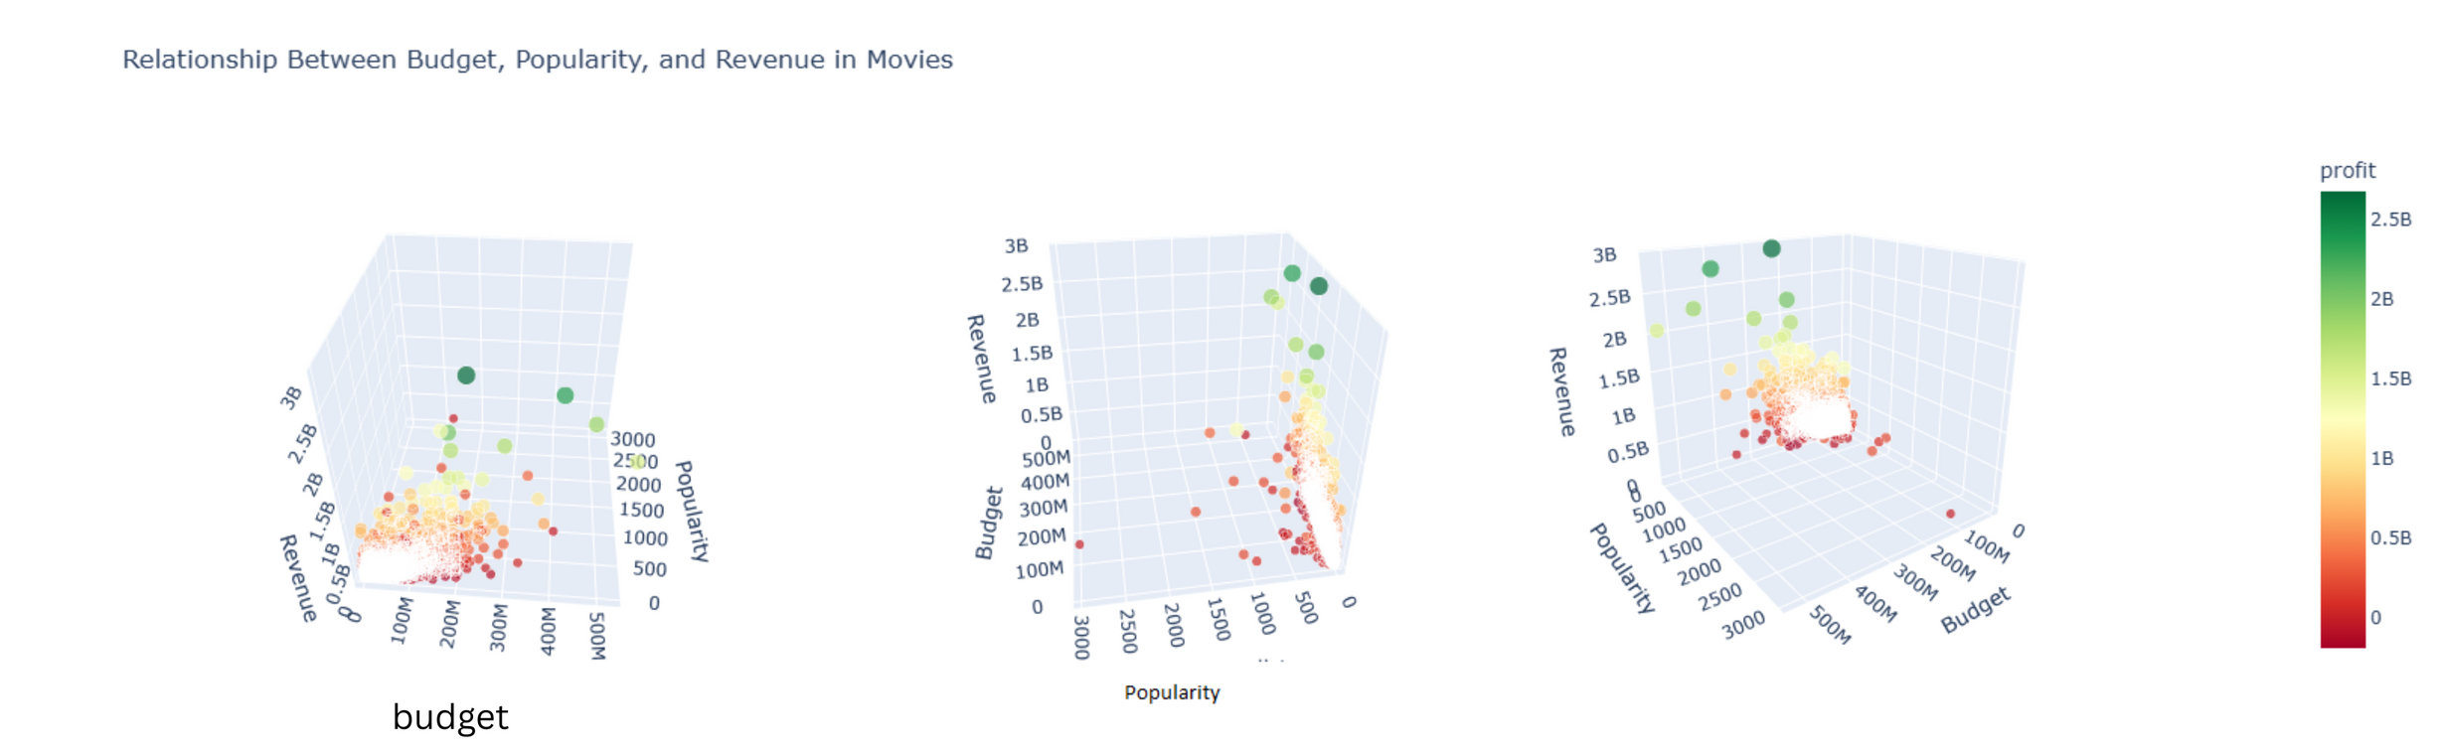
Q11) What other features can we add to increase the correlation with budget and revenue?
Firstly, we want to test with the feature `popularity`. This feature indicates how people were motivated to watch the movie pre-release. Will this feature create a strong connection with the budget and revenue?

Slide 47
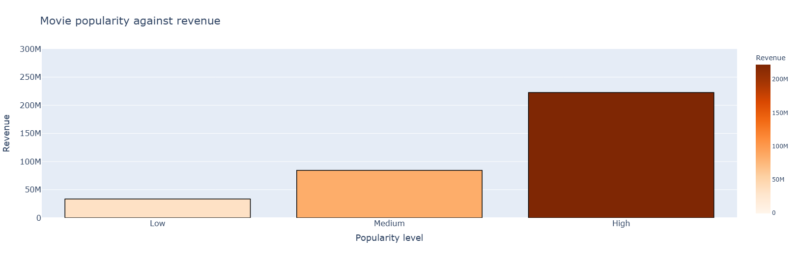
Q11) What other features can we add to increase the correlation with budget and revenue?

Slide 48
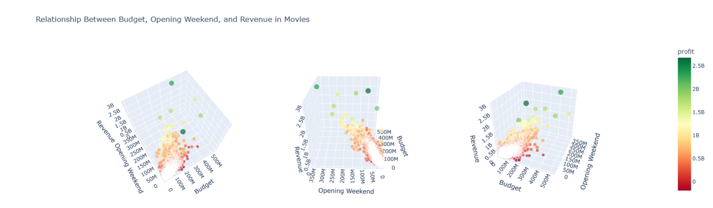
Q11) What other features can we add to increase the correlation with budget and revenue?
Secondly, we add the feature `Opening Weekend (USD)` which indicates how much the movie made within the first week of release.

Slide 49
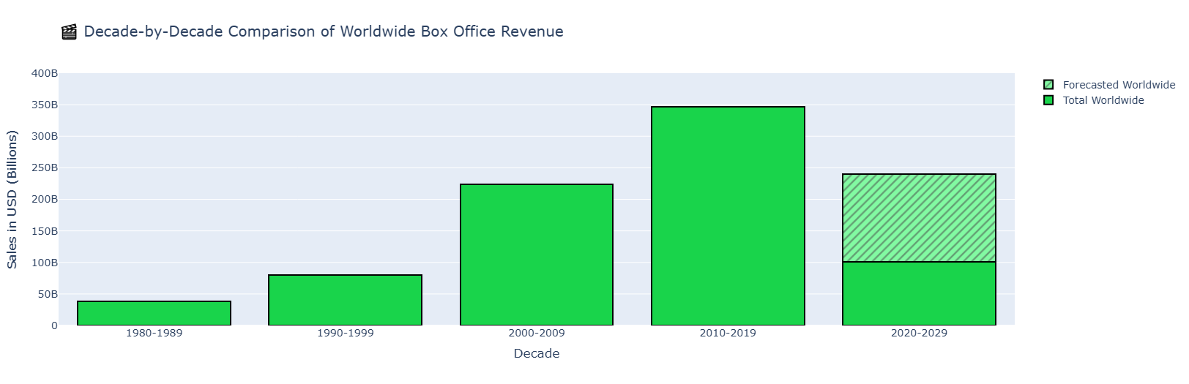
Q12) After learning that movies on average are profitable, what about Box Offices?

Slide 50
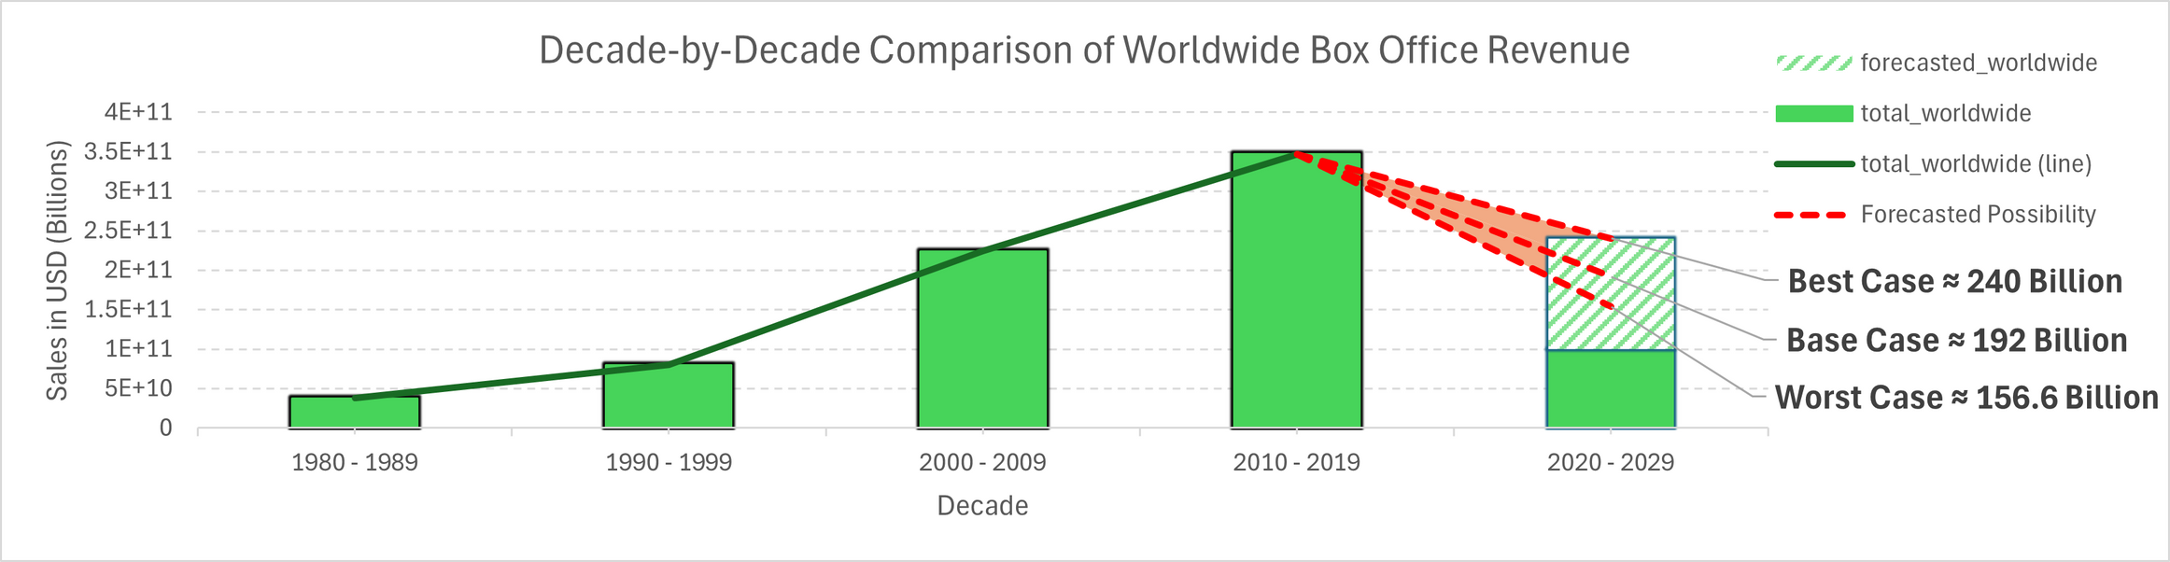
Q12) After learning that movies on average are profitable, what about Box Offices?

Slide 51
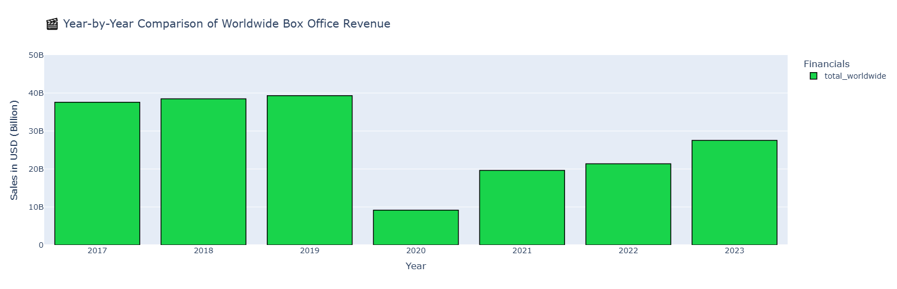
Q12) After learning that movies on average are profitable, what about Box Offices?

Slide 52
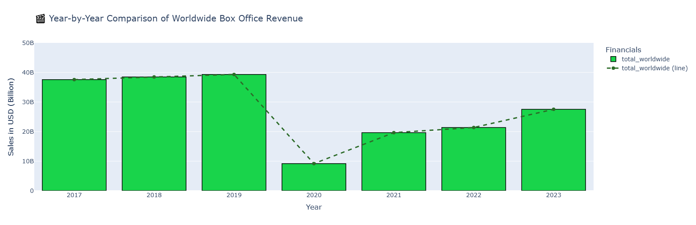
Q12) After learning that movies on average are profitable, what about Box Offices?

Slide 53
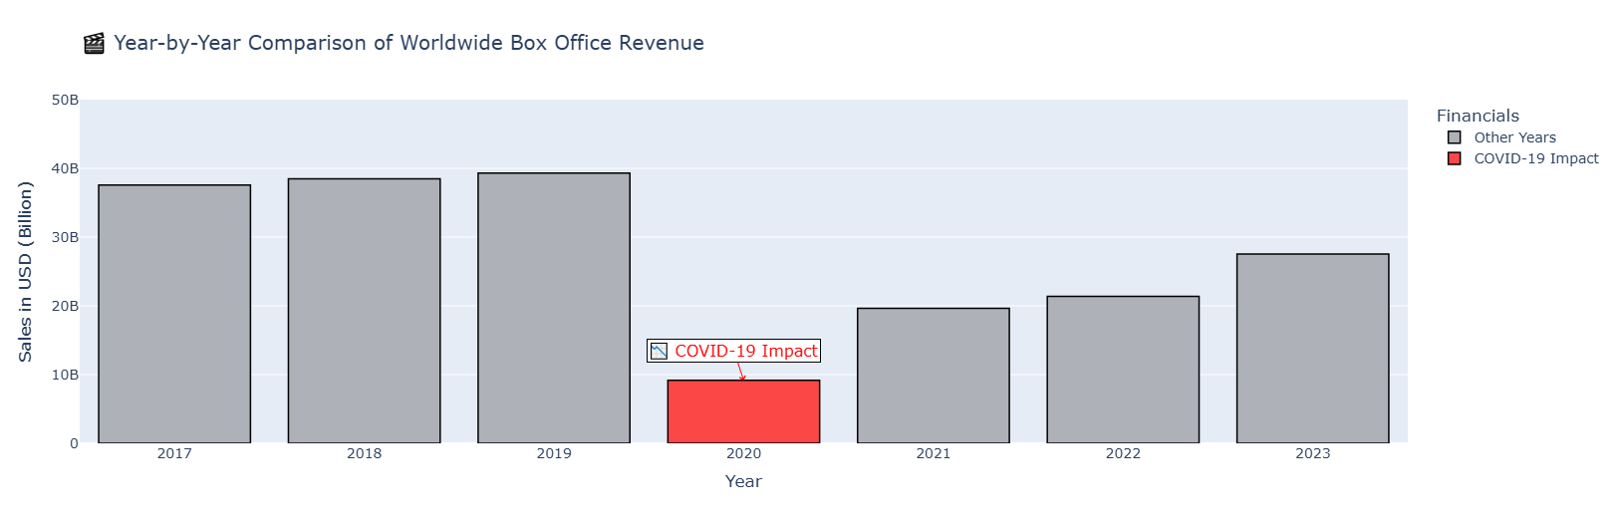
Q12) After learning that movies on average are profitable, what about Box Offices?

Slide 54
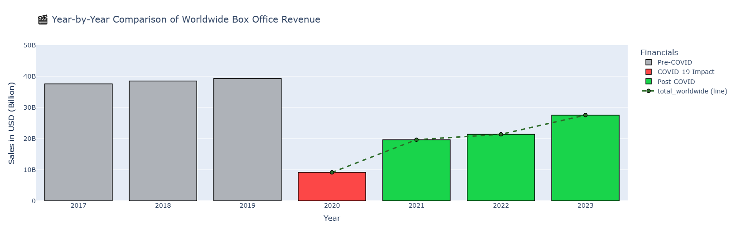
Q12) After learning that movies on average are profitable, what about Box Offices?

Slide 55




Q13) How streaming websites affected box office revenue?

Slide 56
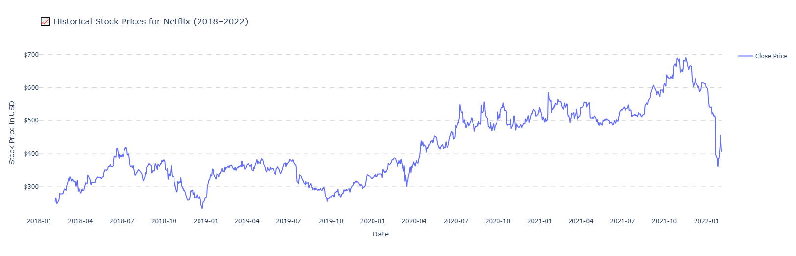
Q13) How streaming websites affected box office revenue?

Slide 57
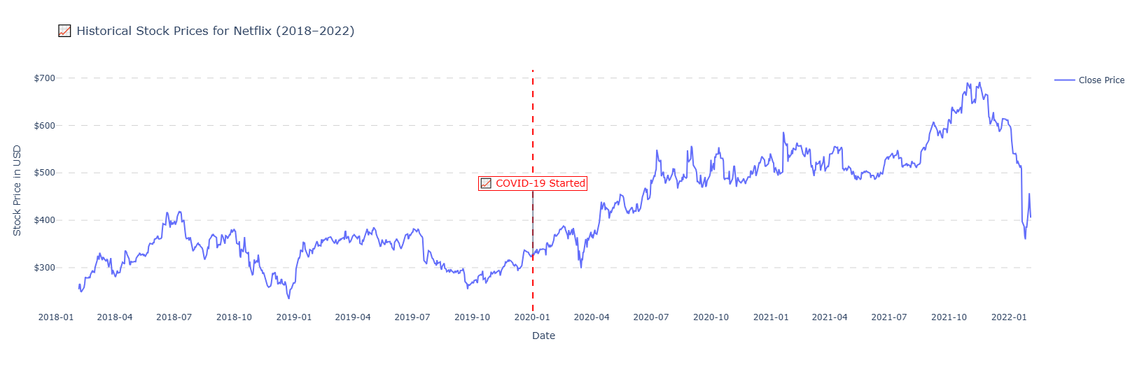
Q13) How streaming websites affected box office revenue?

Slide 58
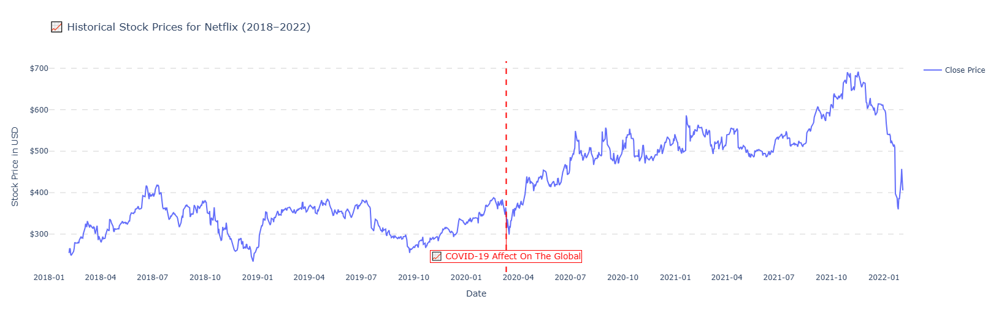
Q13) How streaming websites affected box office revenue?

Slide 59
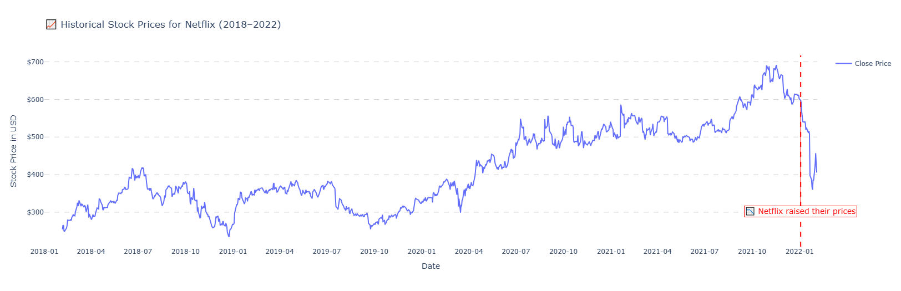
Q13) How streaming websites affected box office revenue?

Slide 60

MachINE LEARNING

Slide 61
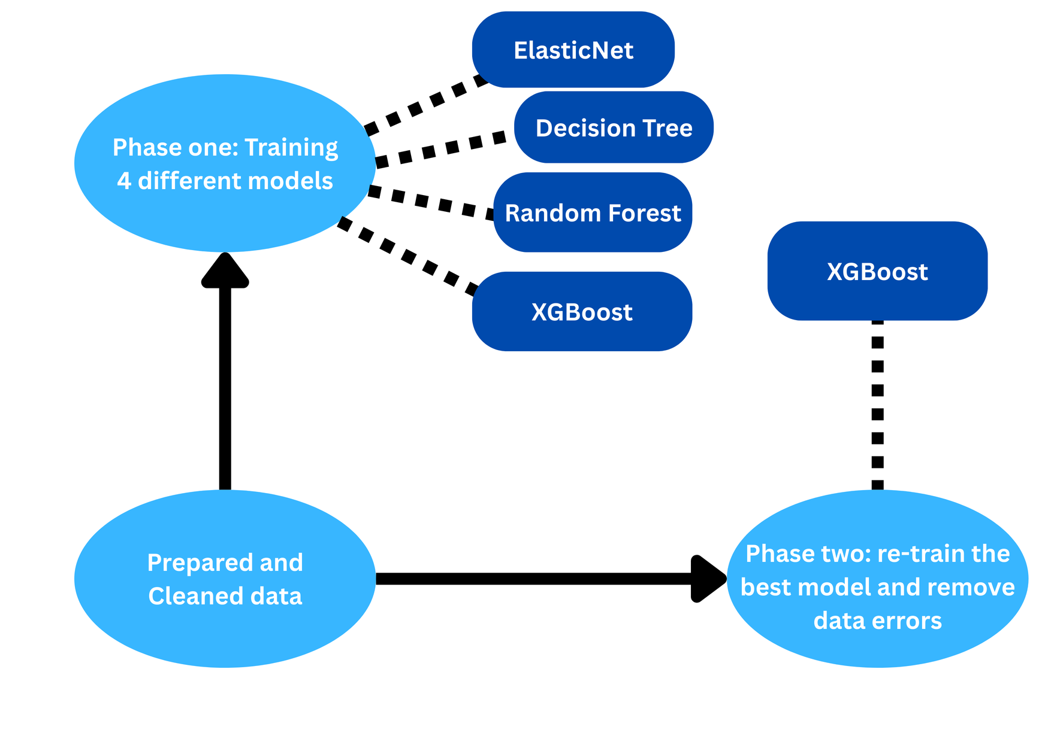
Road Map

Slide 62
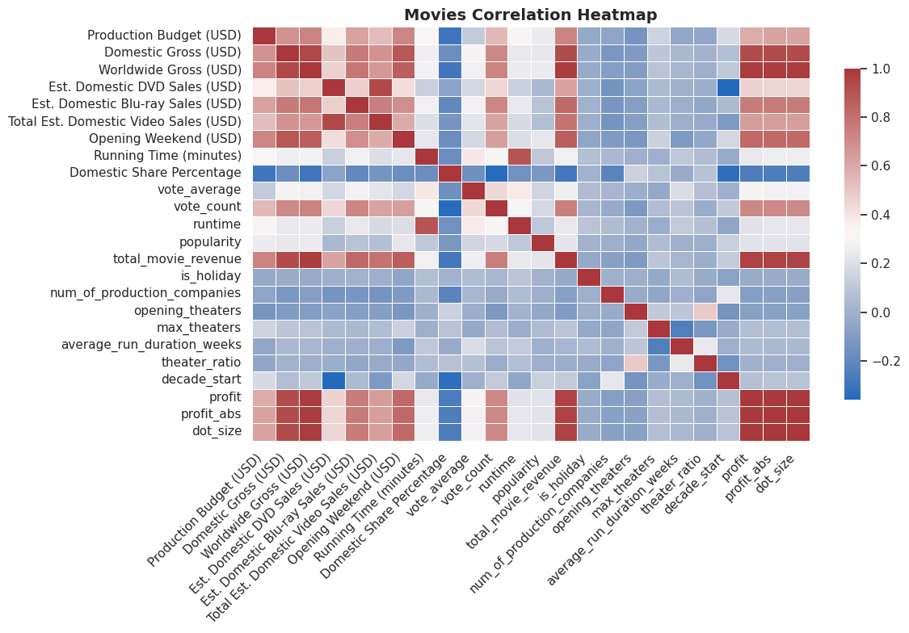
Correlation with all features

Slide 63
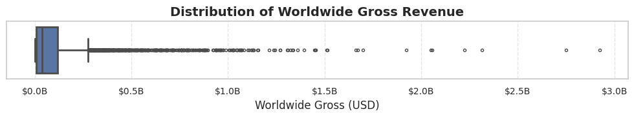
Target outliers

Slide 64
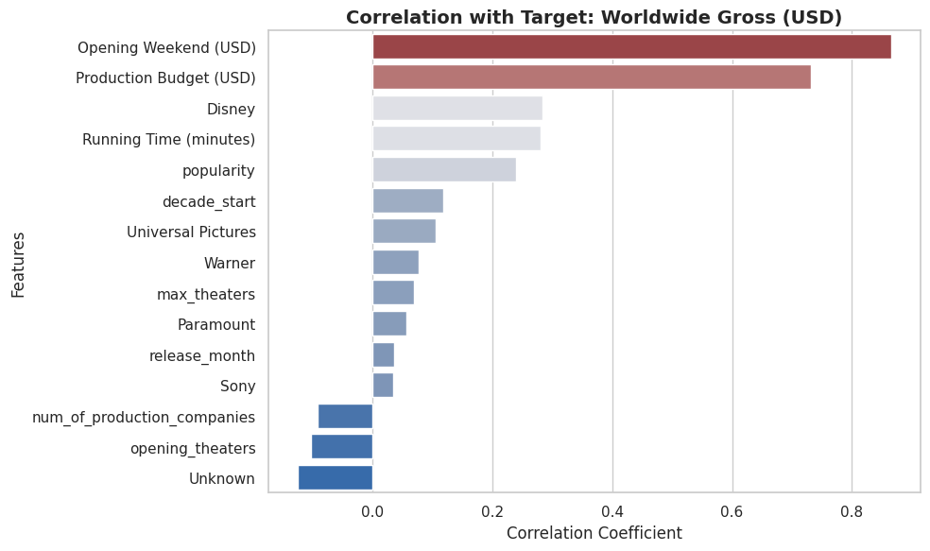
Features correlation with the target

Slide 65

Before transformation the features

Slide 66

After transform the features

Slide 67

Comparison
BEFORE
AFTER

Slide 68

Target Transformation
BEFORE
AFTER

Slide 69

ElasticNet Pipeline

Slide 70


ElasticNet result

Slide 71

Tree based model Pipline

Slide 72


Decision Tree result

Slide 73

Comparison, ElasticNet with Decision Tree

Slide 74


Random Forest result

Slide 75

Comparison, Decision Tree with Random Forest

Slide 76


XGBoost result, first approach

Slide 77

Comparison, Random Forest with XGBoost (Phase one)

Slide 78

Second Approach, remove data entry errors
Using the ratio, gained from the following:
movies['gross_to_budget_ratio'] = movies['Worldwide Gross (USD)'] / movies['Production Budget (USD)']
We removed around 250 data entry errors

Slide 79


XGBoost result, second approach

Slide 80

Comparison, XGBoost (Phase one) with XGBoost (Phase two)

Slide 81


Slide 82



Bonus

